Slide 1
AUTOMATED VIDEO DUBBING SYSTEM
FOR REGIONAL LANGUAGE
A presentation by
Tharun M (220701301)
Tharun R L (220701302)

Slide 2

Agenda
Abstract
Objectives
Existing System
Proposed System
System Architecture
Modules Used
Output

Slide 3
Abstract
This project introduces a web-based, AI-powered video dubbing system that automates the process of transcription, translation, and voice generation. It translates video speech into Tamil (Chennai slang), using technologies like Speechmatics, Google Gemini, and Google Cloud TTS. The goal is to enhance accessibility for regional audiences through natural-sounding, multi-speaker dubbed videos with minimal manual effort.

Slide 4
Objectives
1.Automate video dubbing into Tamil (Chennai slang).
2.Support speaker diarization and voice assignment.
3.Achieve natural, regionally accurate TTS.
4.Provide a simple, user-friendly web interface.
5.Ensure synchronization and high-quality output.

Slide 5
Existing System
Mostly manual, involving human transcribers, translators,
and voice actors.
Limited speaker recognition and slang support.
Robotic-sounding voices and lack of customization.
Expensive, time-consuming, and not scalable for small creators.

Slide 6
Proposed System
1.Fully automated dubbing pipeline using Flask and AI APIs.
2.Transcription (Speechmatics), Translation (RapidAPI), Slang
3.Refinement (Google Gemini).
4.Speaker-specific TTS (Google Cloud TTS).
5.Seamless audio-video merging with Demucs, Pydub & MoviePy.
6.Supports asynchronous processing and temporary file handling.

Slide 7
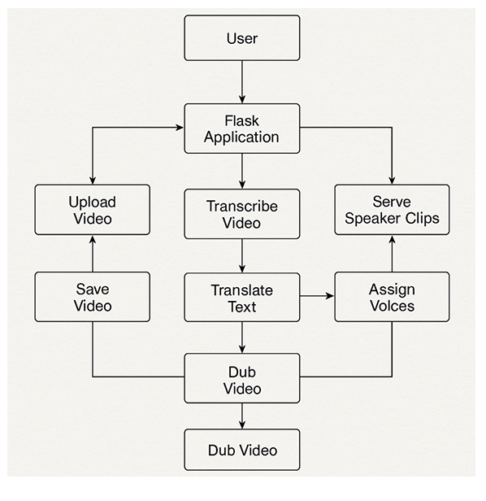
System Architecture

Slide 8
Modules Used
User Interface – HTML/CSS + Flask for upload and interaction.
Audio Extraction – Demucs for separating vocals/background.
Transcription – Speechmatics with speaker diarization.
Translation & Slang – RapidAPI + Gemini for Tamil slang adaptation.
Voice Generation – Google Cloud Text-to-Speech.
Audio Sync – Pydub for overlaying dubbed speech.
Video Reconstruction – MoviePy to generate the final dubbed video.

Slide 9
OUTPUT

Slide 10
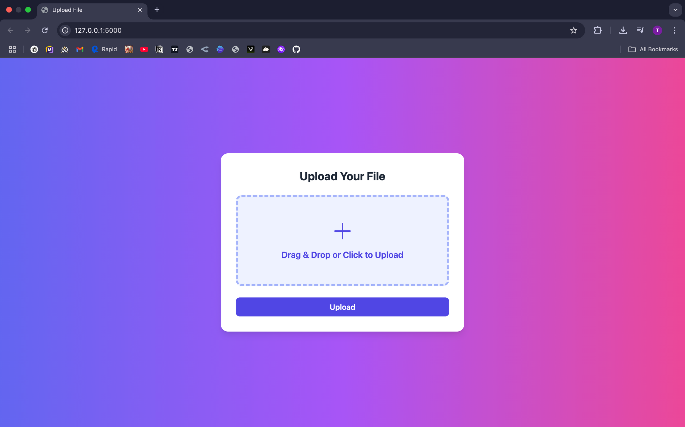

Slide 11
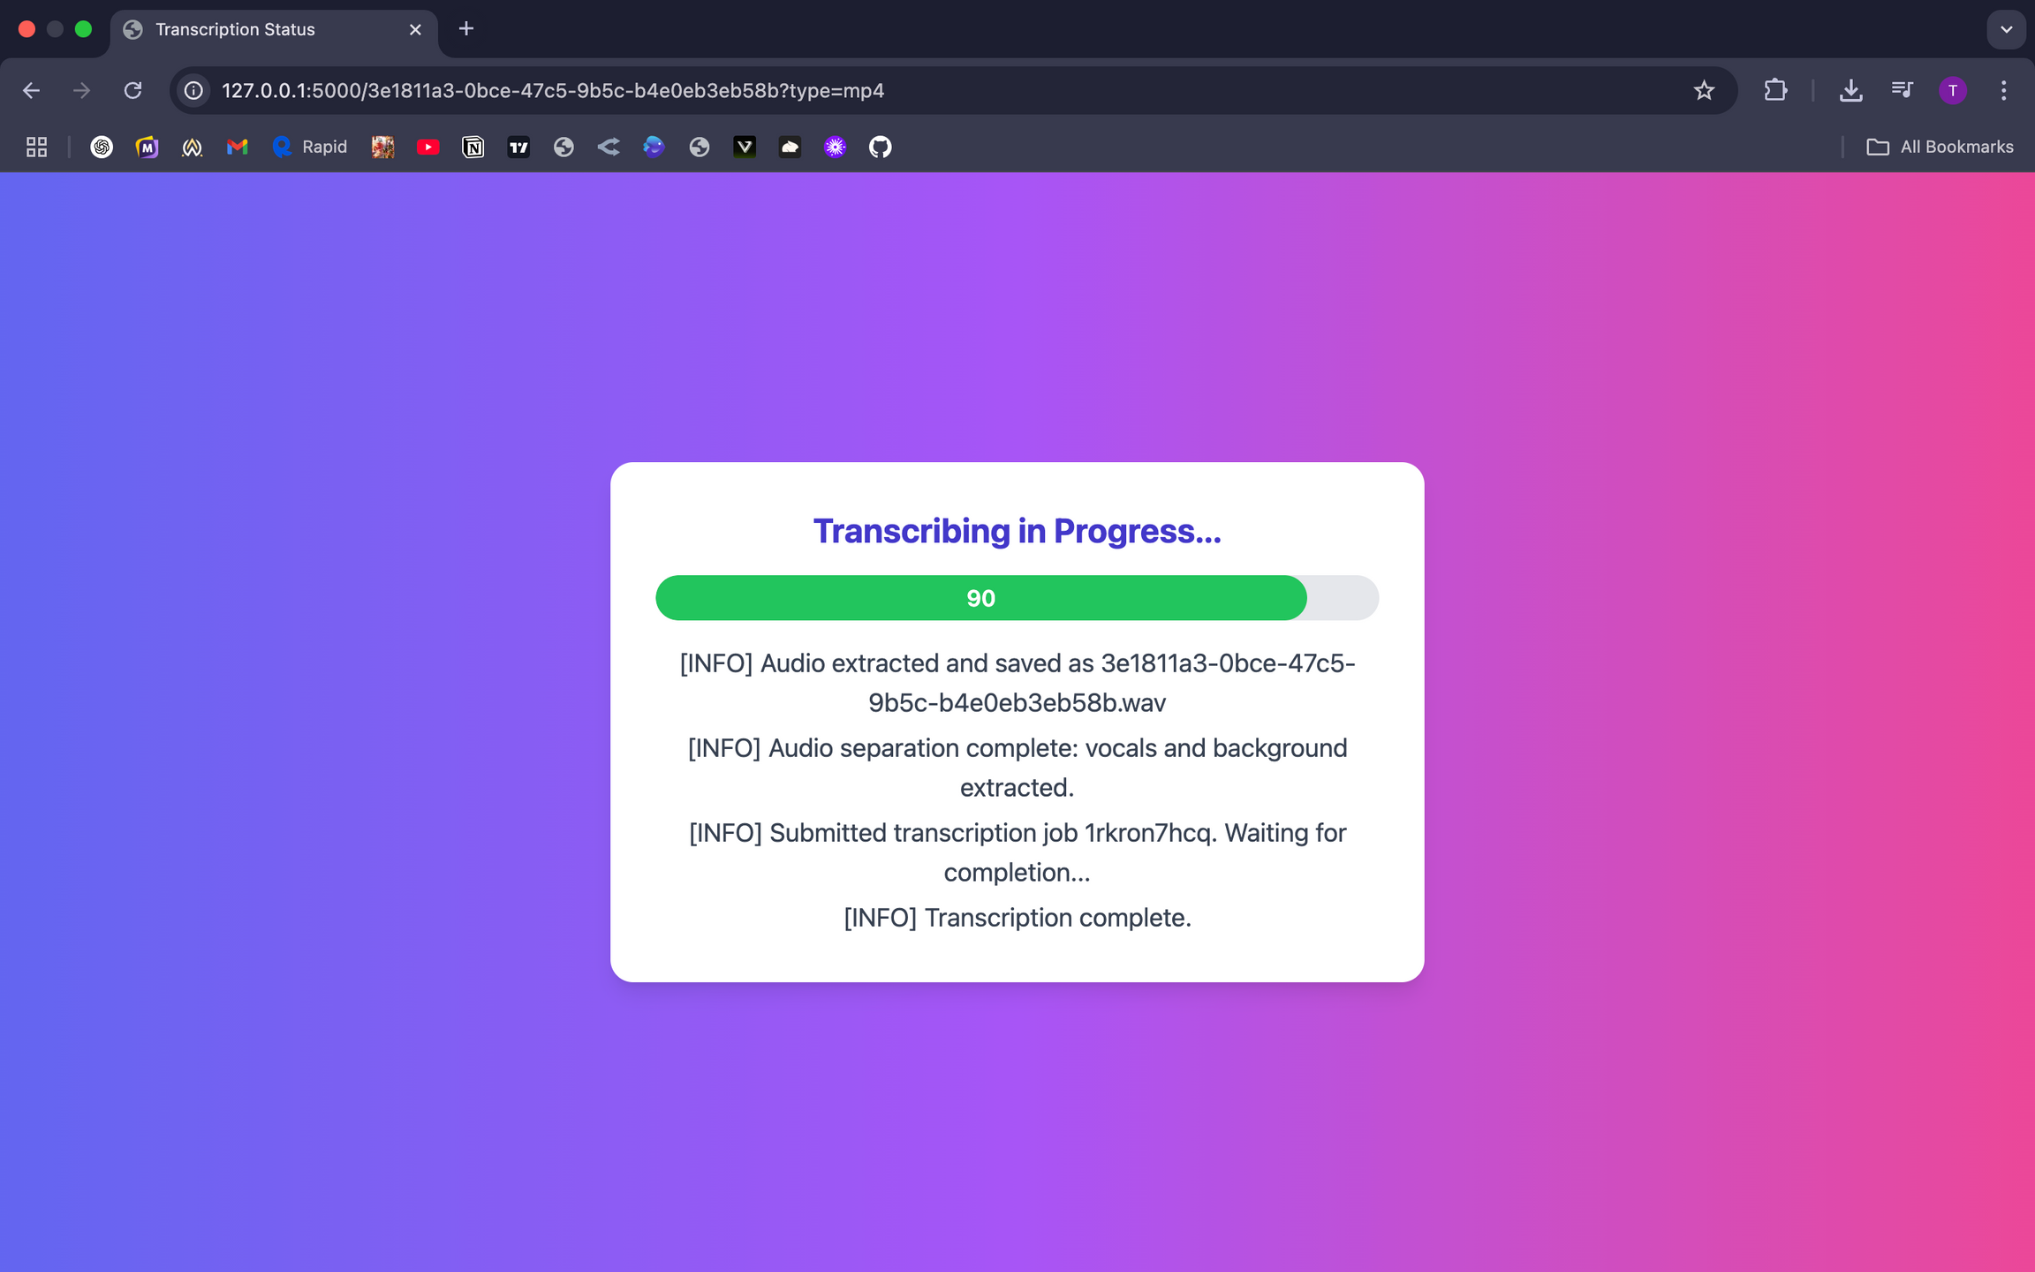

Slide 12
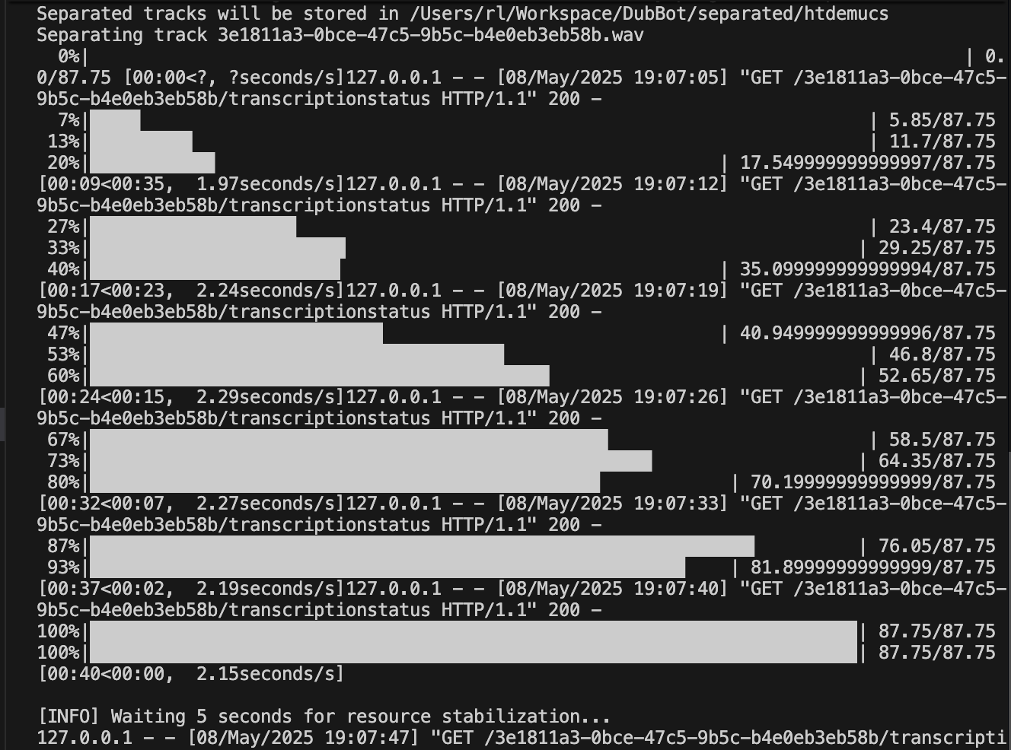

Slide 13
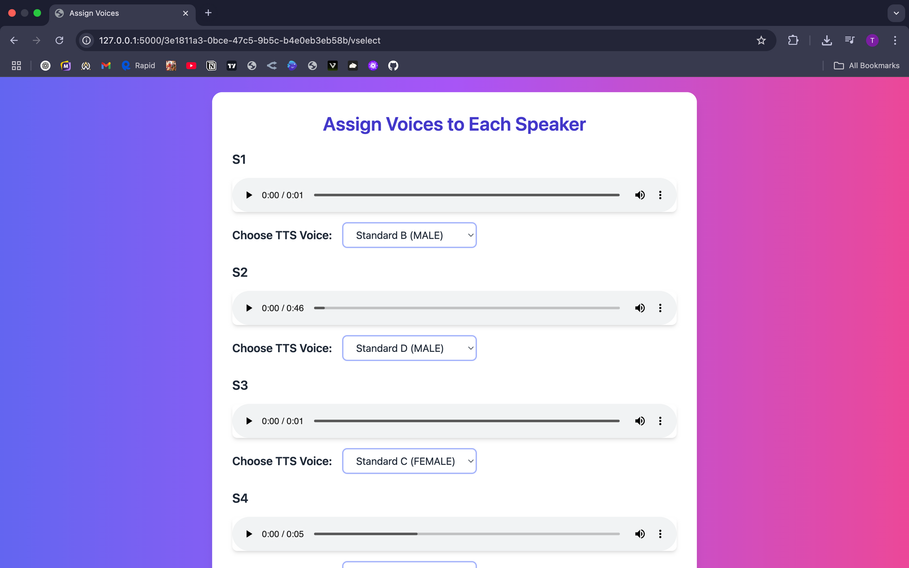

Slide 14
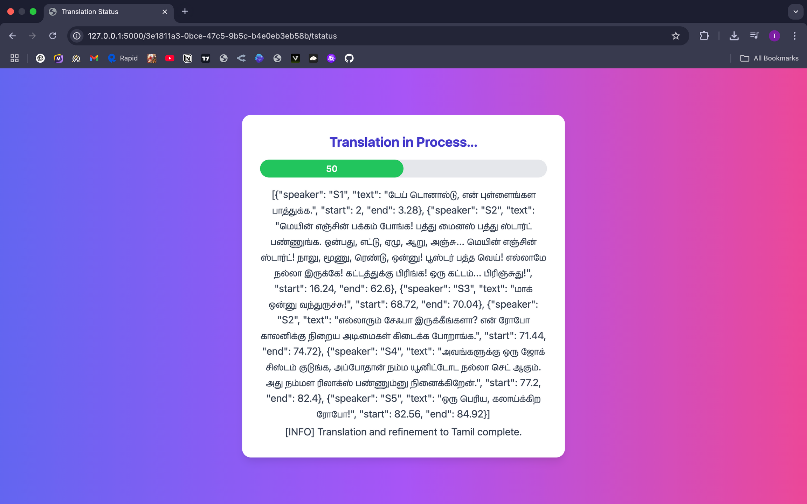

Slide 15
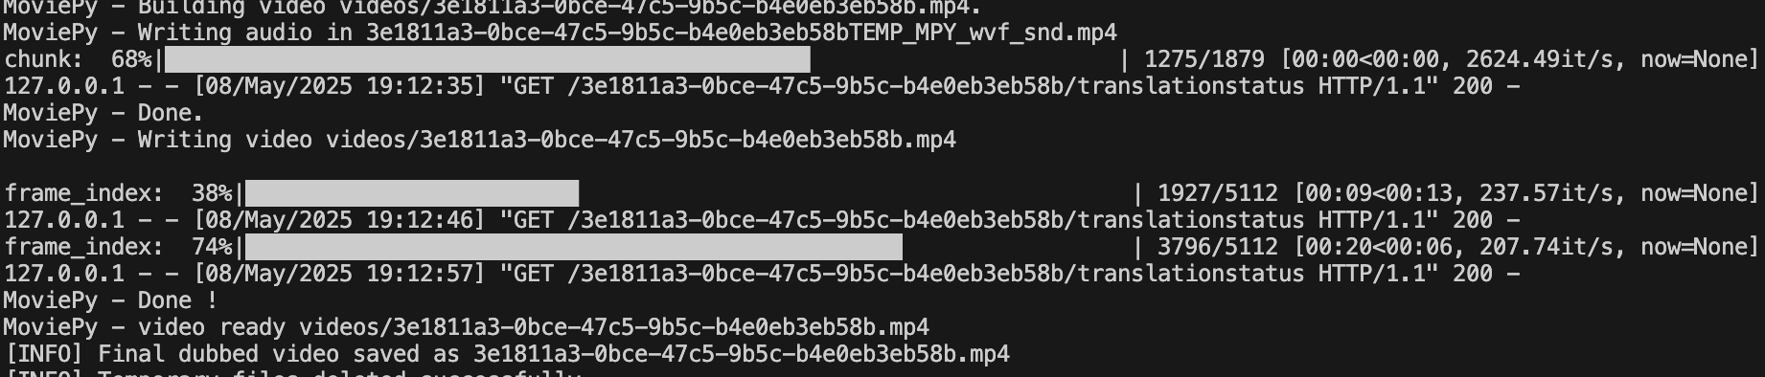

Slide 16
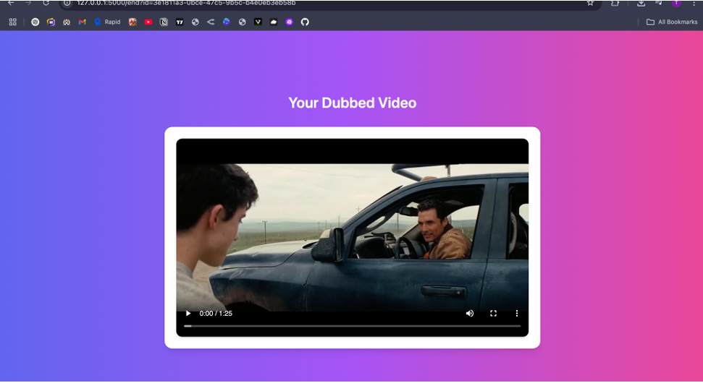

Slide 17
THANK YOU FOR YOUR TIME

